Slide 1
Learning Resource On
Software Project Management
Unit-2
Software Monitoring & Measurements
Prepared By: Kunal Anand
Assistant Professor, SCE KIIT, DU, Bhubaneswar-24

Slide 2
Talkflow
Introduction to Monitoring and Measurements (M & M)
Purpose of M & M
What to do in M & M???
Key metrics in software development
Cost, Size, and Time metrics
Methods for software project metrics
Tools for metrics in SPM
Monitoring responsibility chain
Assessing progress
Project Review
Earned Value analysis
Change control

Slide 3
Monitoring & Measurement of Software
Development
Monitoring and Measurement (M & M) of Software development process is a key part of SPM and software process improvement.
M & M, in software development, are essential for evaluating progress, ensuring quality, and achieving project objectives.
Purpose of M & M is as below:
Ensure the project is on track with respect to cost, schedule, scope, and quality.
Detect problems early and take corrective actions.
Provide objective data for decision-making.
Support process improvement and compliance with standards (e.g., ISO/IEC 12207, CMMI).

Slide 4
What to M & M???
Project Progress: Schedule: Planned vs. actual completion of tasks (Gantt chart, burn-down chart); Effort: Person-hours or person-days consumed vs. estimated; Cost: Budget spent vs. allocated budget.
Product Quality: Defect density: Number of defects per KLOC (thousand lines of code) or per function point; Defect leakage: Defects found after release vs. during development.; Test coverage: Percentage of code or requirements tested.
Process Performance: Productivity: Function points or LOC per person-month; Rework effort: % of total effort spent on fixing defects; Process compliance: Adherence to defined workflows and standards.
Risk Indicators: Number of open issues; High-risk components identified and monitored; Risk exposure index.

Slide 5
contd..
Key metrics in software development – Process metrics
Velocity: Amount of work completed in a sprint or iteration.
Cycle Time: Time taken to complete a task from start to finish.
Lead Time: Total time from task request to delivery.
Work in Progress (WIP): Tasks currently being
worked on.
Product metrics
Defect Density: Number of defects per unit of code or functionality.
Code Coverage: Percentage of code tested by automated tests.
•5

Slide 6
contd..
Technical Debt: Amount of effort needed to fix codebase issues.
Mean Time to Failure (MTTF): Average time the software operates before failing
Quality metrics
Customer Satisfaction (CSAT): Feedback from end-users.
Net Promoter Score (NPS): Likelihood of users recommending the product.
Defect Resolution
defects.
– Team metrics
Time: Time taken to fix identified
Team Morale: Surveys and feedback loops to gauge team satisfaction.
Collaboration Metrics: Frequency and effectiveness of team
communication.
•6

Slide 7
Cost, Size and Time metrics
Cost metrics measure the monetary resources consumed during software development.
Examples: Total development cost, CPI (Cost Performance Index), Budget Variance (BV), Cost per Function Point (CFP), Maintenance cost
Size metrics measure the amount of software functionality or code.
Examples: KLOC, Function Point (FP)
Time metrics measure schedule performance and productivity over time.
Examples: SPI (Schedule Performance Index), Schedule
Variance (SV), Cycle time, Lead time, Velocity.
•7

Slide 8
Methods for Software Project Metrics
These are the approaches used to define, collect, analyze, and use metrics.
Goal-Question-Metric (GQM) Approach
Goal: Define objectives (e.g., improve code quality). Ex: Reduce defects.
Question: Frame questions to evaluate progress (e.g., How many defects per release?). Ex: What is the defect density?
Metric: Identify measurable data points (e.g., Defects per KLOC, DRE).
Statistical Process Control (SPC)
Uses control charts to monitor software process stability.
Identifies variations and trends in productivity, defects, etc.

Slide 9
contd..
C. Benchmarking
–Compare project metrics with:
Historical data from previous projects.
Industry averages (e.g., ISBSG, Capers Jones datasets).
D. Earned Value Analysis (EVA)
Integrates cost, schedule, and scope.
Uses SPI (Schedule Performance Index) and CPI (Cost Performance Index) to track progress.
E. Function Point Analysis (FPA)
Measures software size based on functionalities, not code.
Used to normalize productivity and cost metrics.
F. Trend & Variance Analysis
Compares planned vs. actual over time.
Detects deviations early for corrective action.

Slide 10
Tools for Metrics in SPM
Tool
Jira / Trello
Category
Agile Project Management
Project Scheduling & Tracking
Code Quality Measurement
Purpose
Track velocity, lead time,
cycle time, burndown charts Gantt charts, EVM, resource tracking
LOC, code smells,
complexity, coverage Commits, changes, pull request activity
Trend analysis, SPC
MS Project
SonarQube
Git / GitHub / GitLab Analytics
SPSS / R / Python
QSM SLIM Suite
Function Point Workbench Tableau / Power BI
TestRail Clockify / Toggl
Version Control Metrics
Statistical Analysis
Estimation & Benchmarking ^{Cost, effort, schedule}
forecasting
Size metrics calculation
Dashboards for metrics Test coverage, defect tracking
Effort metrics, productivity
Function Point Counting
Data Visualization Testing Metrics Time Tracking

Slide 11
Issues of metrics in multiple projects
Lack of Standardization
Different projects may use different definitions for the same metric (e.g., “defect” could mean bug, issue, or change request).
Measurement methods vary (manual vs. automated counting).
Units of measurement (LOC vs. Function Points) may not match.
Data Collection Problems
Inconsistent or incomplete data entry by project teams.
Missing historical data for comparison.
Manual data collection prone to human errors.

Slide 12
contd..
Comparability Challenges
Projects may differ in Technology stack (Java, Python,
.NET), Development model (Agile vs. Waterfall), Complexity and domain (banking software vs. mobile apps).
Makes benchmarking across projects unreliable.
Context Sensitivity
Metrics can be misleading without considering project context.
Example: Higher LOC might mean inefficiency in one project but necessary complexity in another.
Cultural and organizational differences affect productivity
metrics.
12

Slide 13
contd..
Misinterpretation of Metrics: Managers may focus on
numbers instead of meaning.
Example: High velocity in Agile might mean more work completed but also higher defect injection if quality is ignored.
Over-reliance on a single metric may lead to wrong decisions.
Tool Integration Issues
Different projects might use different tools (Jira, MS Project, Trello, custom systems) making centralized metric aggregation hard.
Lack of APIs or automated data pipelines.
13

Slide 14
contd..
7. Resistance from Teams
– Developers may feel
metrics are being used for
micromanagement or as a tool for punishment.
– Leads to gaming the
recorded to look good).
8. Maintenance Overhead
system (altering how work is
Tracking too many metrics across projects increases
administrative effort.
May require dedicated personnel or tools, raising costs.
Time Lag in Insights
Metrics from one project may only be analyzed after project completion, making them less useful for real-time decision-making.
Cross-project analysis often delayed due to data cleaning•.₁₄

Slide 15
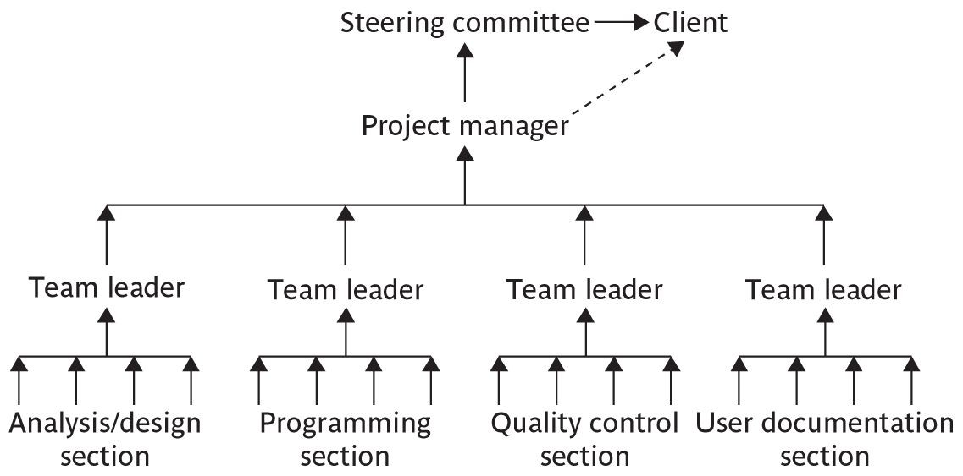
Responsibility Chain in Monitoring

Slide 16

Assessing progress
Checkpoints – predetermined times when progress is checked
Event driven check takes place when a particular event has been achieved
Time driven: date of the check is
pre-determined
Frequency of reporting: The higher the management level then generally the longer the gaps between checkpoints.

Slide 17
Collecting progress details
Need to collect data about:
Achievements
Costs
A big problem: how to deal with partial completions
99% completion syndrome
The "99% Complete Syndrome“ describes the common phenomenon where a project seems almost finished but gets stuck, with the final portion taking disproportionately longer (even as long as the first 99%) due to underestimated complexity, scope creep, integration issues, or overlooked testing, leading to significant delays and frustration despite progress bars racing through the initial stages.
It highlights that the perceived "last mile" of a project often hides the most challenging parts, like debugging, integration, or final approvals, making it seem perpetually incomplete.
Possible solutions:
Control of products, not activities
Subdivide into lots of sub-activities

Slide 18
Red/Amber/Green reporting
Identify key tasks
Break down into sub-tasks
Assess subtasks as:
Green – ‘on target’
Amber – ‘not on target but recoverable’
Red – ‘not on target and recoverable only with difficulty’
Status of ‘critical’ tasks is particularly important.

Slide 19
Review
A cost-effective defect removal mechanism.
Review of work products is an important mechanism for monitoring the progress of a project and ensuring the quality of the work products.
Testing is an effective defect removal mechanism.
However, testing is applicable to only executable code.
Review is applicable to all work products.
Review usually helps to identify any deviation from standards.
Reviewers suggest ways to improve the work product.
A review meeting often provides learning opportunities to not only the author of a work product, but also the other participants of the review meeting.
The review participants gain a good understanding of the work product under review, making it easier for them to interface or use the work product in their work.

Slide 20
Review Roles
Moderator: Schedules and convenes meetings, distributes review materials, leads and moderates review sessions.
Reviewers: Performs the review of the assigned task.
Recorder: Records the defects found and the time and effort data.
Review Process
Planning
Preparation
Rework and follow-up
Review meeting

Slide 21
Project Termination Review
Project termination reviews provide important opportunities to learn from past mistakes as well as successes.
Reasons for project Termination
Project is completed successfully handed over to the customer.
Incomplete requirements
Lack of resources
Some key technologies used in the project have become
obsolete during project execution
– Economics of the project has changed, because many competing product may available in the market.
for example have become

Slide 22
Project Termination Process
Project survey
Collection of objective information
Debriefing meeting
Final project review
Result publication

Slide 23
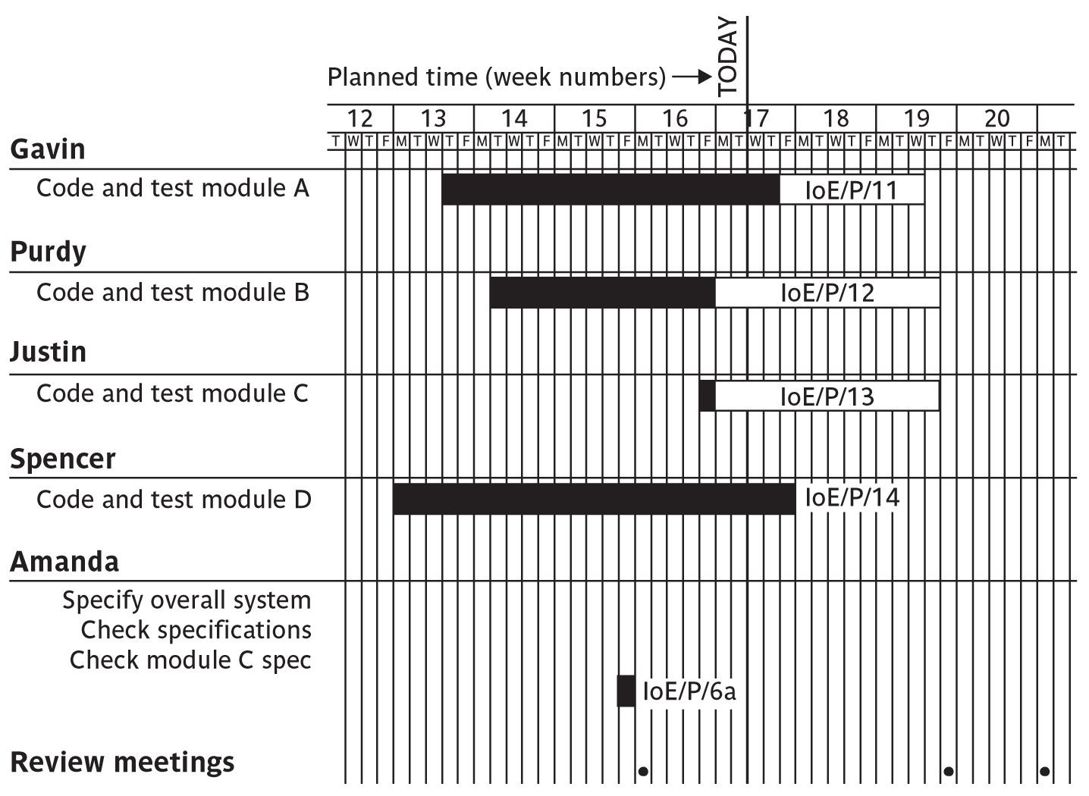
Gantt charts

Slide 24
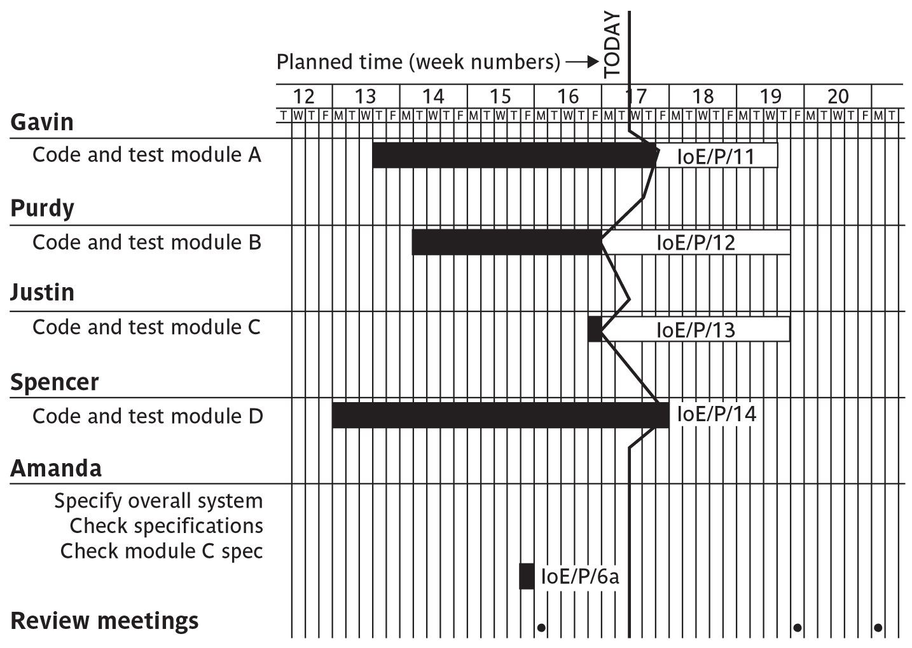
Slip Charts
A slip chart is a version of the Gantt chart where a line is drawn from top to bottom.
To the left of the line are all the completed activities and to the right those activities (or parts of activities) that have not been completed.
The more jagged the line, the more it means that that there are some activities that are lagging to various degrees and some that are ahead of themselves.
A very jagged line means that there is scope for re-planning to move resources from those activities that are ahead to those that are behind.

Slide 25
Cost Monitoring
A project could be late because the staff originally committed have not been deployed.
In this case the project will be behind time but under budget.
A project could be on time but only because additional resources have been added and so be over budget.
Need to monitor both achievements and costs

Slide 26
Earned value analysis
Planned value (PV) or Budgeted cost of work scheduled (BCWS)
original estimate of the effort/cost to complete a task (compare with idea of a ‘price’)
Earned value (EV) or Budgeted cost of work performed
(BCWP)
total of PVs for the work completed at this time

Slide 27
An Example:
Tasks
Specify module: 5 days
Code module:
Test module:
8 days
6 days
At the beginning of day 20, PV = 19 days
If everything but testing completed EV = 13 days
Schedule variance = EV-PV i.e., 13-19 = -6
Schedule performance indicator (SPI) = EV/PV
= 13/19 = 0.68
SV negative or SPI <1.00, project behind schedule

Slide 28
Accounting conventions
Work completed allocated on the basis
50/50: half allocated at start, the other half on completion.
These proportions can vary e.g., 0/100, 75/25 etc
Milestone current value depends on the milestones achieved.
Units processed.
Can use money values, or staff effort as a surrogate

Slide 29
Earned Value analysis – actual cost
Actual cost (AC) is also known as Actual cost of work performed (ACWP)
In previous example, if
‘Specify module’ took 3 days
‘Code module’ took 4 days
Actual cost = 7 days
Cost variance (CV) = EV-AC
i.e., 13-7 = 6 days
Cost performance indicator (CPI)= EV / AC
= 13/7 = 1.86
Positive CV or CPI > 1.00 means project within budget.

Slide 30
contd..
CPI can be used to produce new cost estimate
Budget at completion (BAC) – current budget allocated to total costs of project
Estimate at completion (EAC) – updated estimate
= BAC/CPI
e.g., say budget at completion is £19,000 and CPI is 1.86
EAC = BAC/CPI = £10,215 (projected costs reduced because work being completed in less time)
Time variance (TV) – difference between time when specified EV should have been reached and time it was.
For example, say an EV of £19000 was supposed to have been reached on 1st April and it reached on 1st July then TV = - 3 months

Slide 31
Earned value chart with revised forecasts
This shows how the planned value (PV), earned value (EV) and actual cost (AC) can be tracked over the lifetime of a project.
It also shows how the graph can be used to show adjustments to the final estimated cost and duration.
A revised assessment of the budget at completion (EAC estimate at completion) can be produced by dividing the original estimated budget at completion (BAC) by the current CPI.
Similarly, a forecast of the actual duration of the project can be derived by dividing the original estimated duration by the SPI.

Slide 32
Prioritizing Monitoring
We might focus more on monitoring certain types of activity e.g.
Critical path activities
Activities with no free float – if delayed later dependent activities are delayed
Activities with less than a specified float
High risk activities
Activities using critical resources

Slide 33
Getting back on track: options
Renegotiate the deadline – if not possible then
Try to shorten critical path e.g.
Work overtime
Re-allocate staff from less pressing work
Buy in more staff
Reconsider activity dependencies
Over-lap the activities so that the start of one activity does not have to wait for completion of another
Split activities

Slide 34
Change Control
The role of configuration librarian:
Identifying items that need to be subject to change control
Management of a central repository of the master copies of software and documentation
Administering change procedures
Maintenance of access records

Slide 35
Typical change control process
One or more users might perceive the need for a change
User management decide that the change is valid and worthwhile and pass it to development management
A developer is assigned to assess the practicality and cost of making the change
Development management report back to user management on the cost of the change; user management decide whether to go ahead
One or more developers are authorized to make copies of components to be modified
Copies modified. After initial testing, a test version might be released to users for acceptance testing
When users are satisfied then operational release authorized – master configuration items updated

Slide 36
Software Configuration Management
The deliverables of a SW product consist of a number of objects, e.g. source code, design document, SRS document, test document, user’s manual, etc.
These objects are modified by many software engineers through out development cycle.
The state of each object changes as bugs are detected and fixed during development .
The configuration of the software is the state of all project deliverables at any point of time.
SCM deals with effectively tracking and controlling the configuration of a software during its life cycle.

Slide 37
Necessity of SCM
To control access to deliverable objects with a view to avoiding the following problems
Inconsistency problem when the objects are replicated.
Problems associated with concurrent access.
Providing a stable development environment.
System accounting and status information.
Handling variants. If a bug is found in one of the variants, it has to be fixed in all variants
SCM activities
Configuration identification : deciding which objects (configuration items ) are to be kept track of.
Configuration control : ensuring that changes to a system happen without ambiguity.
Baseline: When an effective SCM is in place, the manager freezes the objects to form a base line.
A baseline is the status of all the objects under configuration control. When any of the objects under configuration control is changed , a ne^{•3}w⁷ baseline is formed.

Slide 38
Configuration item identification
Categories of objects:
Controlled objects are under Configuration Control (CC) . Formal procedures followed to change them.
Pre-controlled objects are not yet under CC, but will eventually be under CC.
Uncontrolled objects are not subjected to CC
Controllable objects include both controlled and precontrolled objects; examples: SRS document, Design documents, Source code , Test cases
The SCM plan is written during the project planning phase, and it lists all controlled objects.
Configuration Control (CC): process of managing changes to controlled objects. Allows authorized changes to the controlled objects and prevents unauthorized changes .
In order to change a controlled object such as a module, a developer can get a private copy of the module by a reserve operation .
Configuration management tools allow only one person to reserve a module at a time. Once an object is reserved, it does not allow any one else to
reserve this module until the reserved module is restored .
38

Slide 39
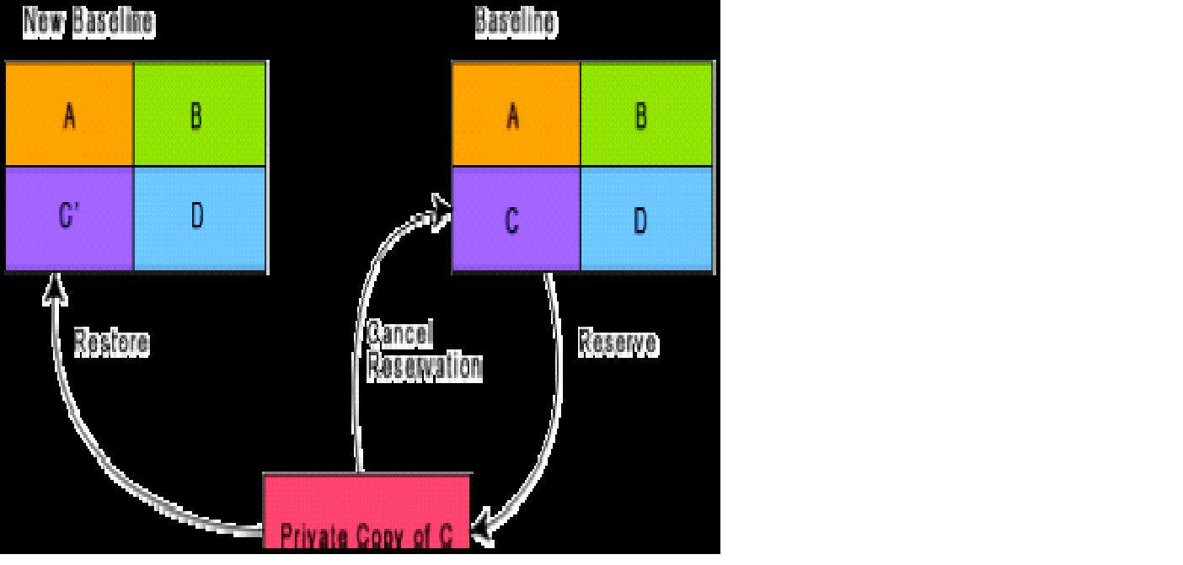
Changing the Baseline
When one needs to change an object under configuration control, he is provided with a copy of the base line item.
The requester makes changes to his private copy.
After modifications, updated item replaces the old item and a new base line gets formed .
Reserve and restore operation in configuration control
obtains a private copy of the module through a reserve operation and carries out all changes on this private copy.
restoring the changed module to the baseline requires the permission of a change control board(CCB).
Except for very large projects, the functions of the CCB are discharged by the project manager himself.
39

